Slide 1
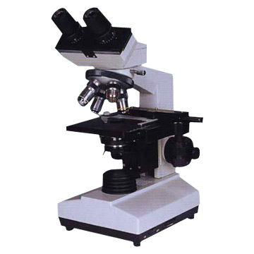
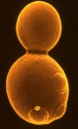
Yeast replicative lifespan determination by manual dissection is a tedious process
daughter
discard
mother
Repeat
until mother
ceases
to divide
agar plate

Slide 2
Existing microfluidic designs have flaws and are low throughput

Slide 3
An innovative design to capture single yeast cells - HYAA
16 channels in 4 groups
520 single-cell traps in each chamber
Jo et al., PNAS, 2015

Slide 4
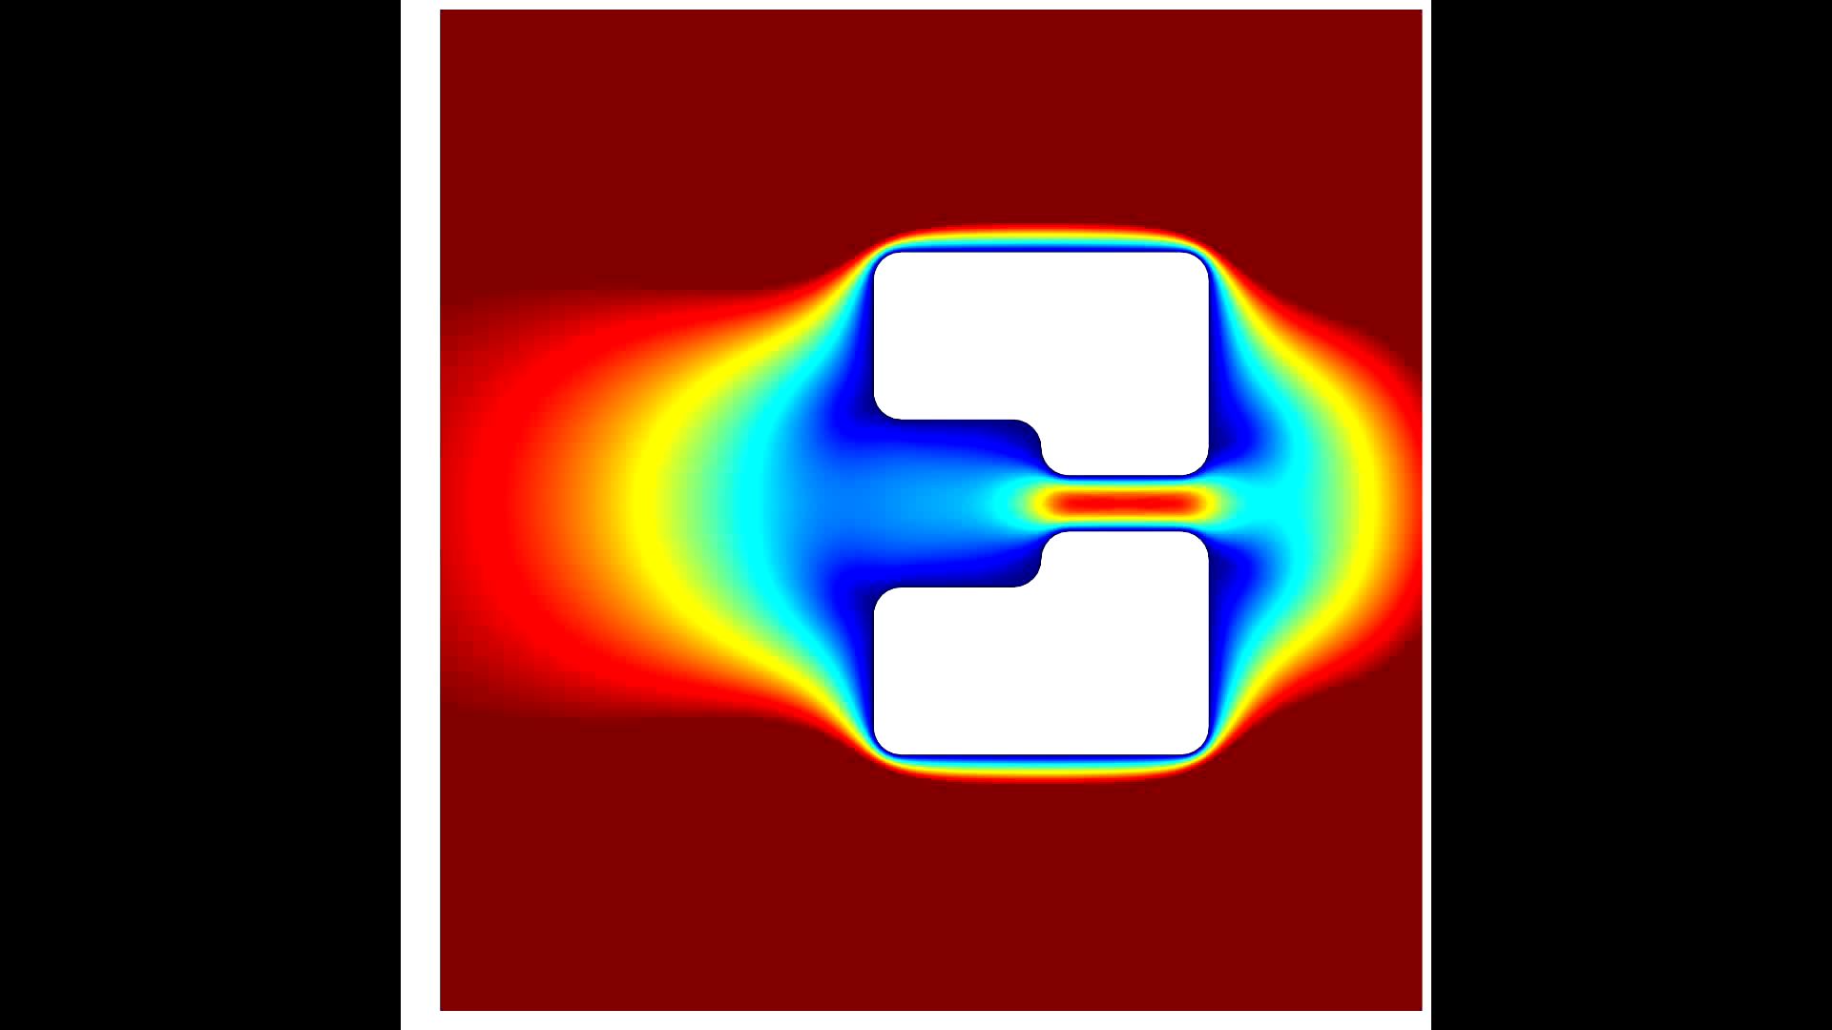
Optimized for single-cell capture
Jo et al., PNAS, 2015

Slide 5
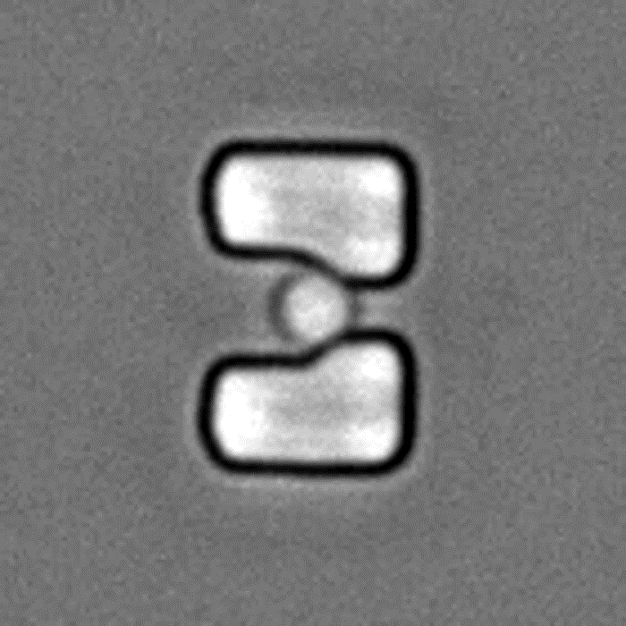
Accurate yeast replicative lifespan assays in high-throughput
Jo et al., PNAS, 2015

Slide 6
Comparison between microdissection and microfluidic based lifespan assays
 | Dissection | Heinemann | Swain | HYAA
Time req. | 4-6 weeks | 60-80 Hrs | 60-80 Hrs | 60-80 Hrs
# of media | 2-3 | 1 | 1 | 4
Strains | 2-10 | 1 | 1 | 1-16
# of cells | 200-300 | 50-100 | 1000 | 8000
Cell retention | N/A | 14% | 60% | 90%
Single cell capture | N/A | No | Yes | Yes
Bright field microscopy | Manual | Automatic | Automatic | Automatic
Fluorescent microscopy | No | Yes | Yes | Yes
I am happy to report that we successfully constructed several chips from these files and they worked in our hands, exactly as you described! We have tried several of the published devices and yours is the first that works so well.
- Dan Gottschling, Calico and member of NAS

